Slide 1
Uncontrolled copy not subject to amendment
Principles of Flight
Learning Outcome 4
Know the principles of flight and control for rotary wing aircraft
Identify the features of rotary wing aircraft that enable flight and control
Revision 2.00

Slide 2
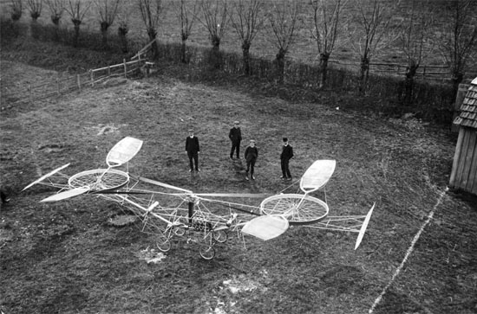
Principles of Flight
Revision

Slide 3
Questions for you …..

Slide 4
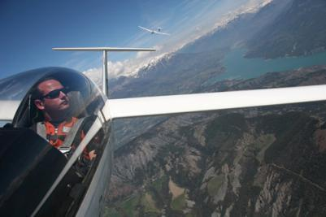
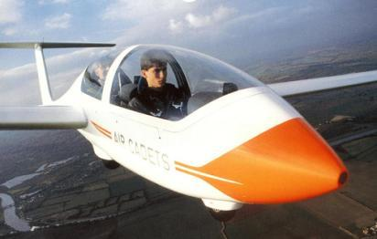
Name the forces acting on a glider in normal flight
a. Force, weight and lift
b. Drag, weight and thrust
c. Drag, weight and lift
d. Drag, thrust and lift

Slide 5
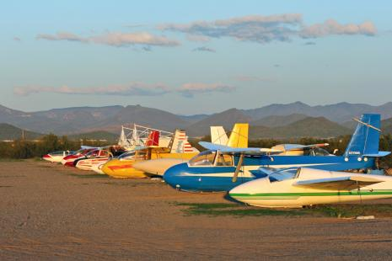
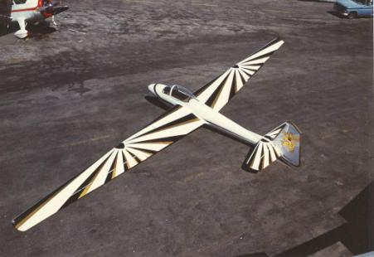
How does a glider pilot Increase airspeed?
a. Operate the airbrakes
b. Lower the nose by pushing the stick forward
    Raise the nose by pulling the stick back
d. Lower the nose by pulling the stick back

Slide 6
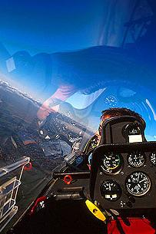
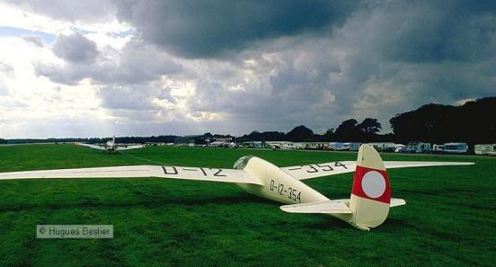
3. A Viking glider descends from 1640 ft (0.5 km). How far over the ground does it travel (in still air)?
a. 17.5 km
b. 35 km
c. 70 km
d. 8.75 km

Slide 7
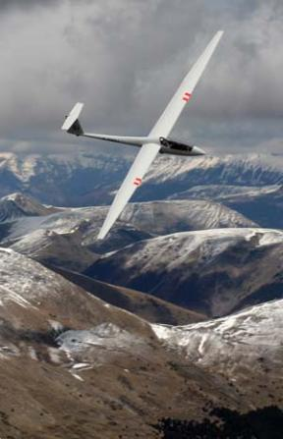
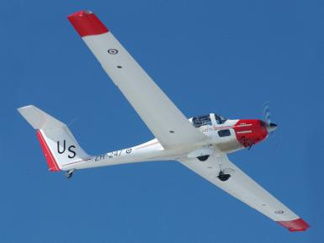
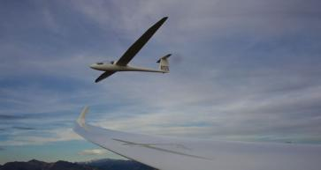
4. When flying into a headwind, the distance covered over the ground will .....
a. Be the same
b. Decrease
c. Increase
d. Take you to Burger King

Slide 8
Rotary wing aircraft
Objectives:
State the method of generating lift for a helicopter
Describe blades, rotor head, pitch angle, collective pitch, rotor disc, cyclic pitch, tail rotor, hand throttle, torque reaction
Explain how a helicopter achieves horizontal flight
Describe the operation of the following controls:
The collective
The cyclic
The yaw pedals
The hand throttle

Slide 9
How does a wing produce lift?
Do you remember the wind tunnel?

Slide 10
Lift
-
-
A
+
+
C
B
Air enters at A
On reaching B it has increased in speed to get through the narrower gap
At C the air has returned to the same values as A
If speed increases then pressure drops (and vice versa)
So how does this work as a wing?
Notes:
Air flowing past a stationary object.
Air blows from A to C through a restriction.
Air cannot be “stored” at B, so something else happens.
From A to B the airspeed increase and slows from B to C.
This affects the pressure of the air.
This is a complicated theory but all we need to know is that if the air speeds up when passing B then the air pressure drops.
Can discuss that the sum of the energies is constant.
Remember the 2 pieces of paper when blowing between?
Could mention a “Venturi”.

Slide 11
LIFT
-
-
A
+
+
C
B
A wing works in the same way as the wind tunnel
Because the air is faster over the top surface, the pressure is decreased
The wing is now producing lift
Notes:
Now cut the “wind tunnel in half and we have a wing, which works in the same way.
Replace the tunnel with a wing and the effect is the same.
Can discuss that when the curvature (camber) is greater then more lift is generated.
Now you know why it is not a good idea to stand close to a railway platform’s edge!

Slide 12
Rotary wing aircraft
Instead of moving the wing through the air as with a fixed wing aircraft, we rotate the “wing”
The cross section of a blade is the same shape as a wing
The rotating “wing” is now producing lift
Notes:
The main rotor of a helicopter might not look like wings at first sight, but it is. A cross-section of a rotor blade has an aerofoil shape, similar to that of a conventional aircraft wing. Therefore, when a rotor blade moves through the air it can be made to generate lift. The helicopter’s engine is used to make the blades rotate - that is, move through the air - and this can be done even when the aircraft is stationary. Thus, all that is needed to ensure that the rotor generates enough lift to make the helicopter rise off the ground, is to rotate the wings fast enough and give them an angle of attack to the airflow. The blades of the main rotor are fitted into the hub (or rotor head) so that they can be twisted. That is, the angle between the chord line of the blade’s aerofoil section and its plane of rotation (its “pitch angle”) can be varied, which alters the angle of attack and allows the pilot to vary the amount of lift.
The lift generated is less than the aircraft’s weight, and the helicopter stays on the ground.
When the pitch angle of each blade, and hence the angles of attack of all the main rotor blades is altered by the same amount and at the same time, it is known as a “collective” alteration of pitch. The pilot’s control which does this is therefore called the collective pitch control.

Slide 13
How does a helicopter climb and descend?
Lift
Chord
Relative airflow
Angle of attack

Slide 14
Climbing
How can the “wing” produce more lift?
Lift
Increase the angle of attack (AoA)
Chord
Chord
Relative airflow
Angle of attack

Slide 15
Descending
How can the “wing” produce less lift?
Lift
Decrease the angle of attack (AoA)
Increasing or decreasing rotor speed will also affect lift production

Slide 16
Parts of a helicopter
Blades
Tail rotor
Rotor head
Rotor disc

Slide 17
Helicopter controls
The collective pitch lever
The hand throttle
The cyclic pitch control
The tail rotor control (or yaw pedals)

Slide 18
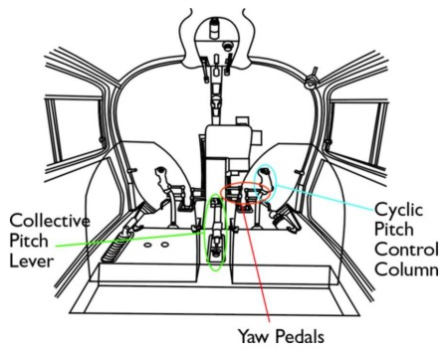

Slide 19
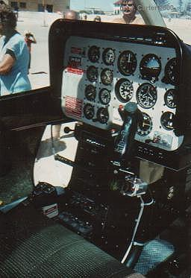
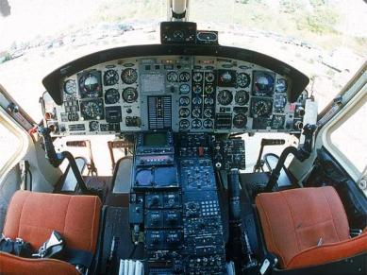
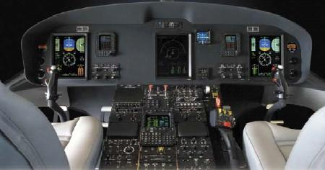
Cyclic pitch control column
Notes:
By tilting the rotational disc of the main rotor away from the horizontal, the cyclic pitch control is used to make the aircraft move horizontally. It is normally operated by the pilot’s right hand, and is similar to the fixed wing aircraft’s control column, (or “stick”). If the stick is moved forward, the disc is inclined forward and the helicopter moves into forward flight. The stick can be moved in any direction, tilting the disc in the same direction to move the helicopter forwards, sideways or backwards.

Slide 20
Collective pitch lever

Slide 21
Tail rotor control (or yaw pedals)
Notes:
We now have the pilot operating the throttle and collective pitch control with the left hand and the cyclic control with the right hand. This leaves the feet for the tail rotor, which controls the aircraft in yaw (ie directional control). The pilot’s feet rest on rudder pedals similar to those of a fixed-wing aircraft. If the left pedal is pushed forward, the nose of the helicopter yaws to the left; right pedal, right yaw. Primarily the purpose of the tail rotor control is to oppose the tendency of the main rotor to make the fuselage rotate - that is, to achieve balanced flight. However, facility to yaw the aircraft (to change the direction in which it is pointing) can be very useful in certain aerobatic manoeuvres and when hovering.

Slide 22
Cyclic
Collective
Yaw Pedals

Slide 23
The collective pitch lever
Hand throttle
The collective pitch lever often contains a hand throttle (like on a motor cycle)
Notes:
The collective pitch control, (or “lever”) which changes the pitch angle of all the blades of the rotor by the same amount at the same time, controls the vertical movement of the helicopter. It is normally on the pilot’s left, for operation by the left hand. The lever is moved up to increase the pitch angle of the blades and down to decrease the angle. When the pitch angle of the blades is increased, the angle of attack and thus the lift will be increased and the helicopter will rise off the ground. However, with increased angle of attack the drag of the blades becomes greater, hence more power is required to keep them rotating at the correct speed. For this reason the lever is attached to a cam arrangement which slightly opens the engine throttle as the lever is moved up, and slightly closes it when the lever is moved down. It works well for small movements of the lever, but something extra is needed for larger movements and the extra device is the hand throttle.
The hand throttle is situated on the end of the collective lever; it is a twist-grip control similar to a motor cycle throttle. The pilot holds the collective pitch control by the twist-grip hand throttle and so can operate both at the same time.

Slide 24
Rotor blade
All blades are changed by the same angle

Slide 26
Torque reaction - yaw
Fuselage torque reaction
What can be done to stop this?
Notes:
When the engine of a helicopter drives the rotor in its circular motion, there is a tendency for an opposing force (called “torque reaction”) to spin the fuselage of the helicopter the opposite way. The normal solution on a single-rotor helicopter is to fit a small rotor, far back on the tail for leverage, with its rotational disc vertical. Its horizontal thrust force opposes the fuselage torque reaction and permits balanced flight. The pilot can vary the thrust force provided by the tail rotor, to maintain balanced flight or to yaw the aircraft at will (very useful when hovering).
The pilot alters the thrust of the tail rotor by changing the pitch angle and hence the angle of attack of the tail rotor blades, giving more thrust or less thrust or even negative thrust as required. Helicopters with twin main rotors such as the Chinook have each rotor revolving in an opposite direction. The torque reaction from one thus counteracts the other.

Slide 27
A tail rotor is added to counter the torque reaction
Airflow
Balancing force
Which control is used for this?

Slide 28
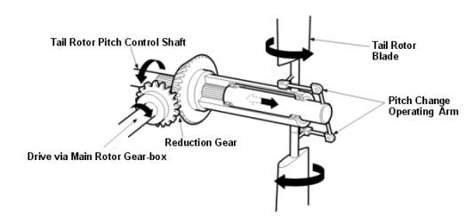
The yaw pedals
Moving the yaw pedals will alter the blade pitch equally on all the tail rotor blades
Yaw Pedals
The yaw pedals can also be used to turn (yaw) the helicopter around the main rotor

Slide 29
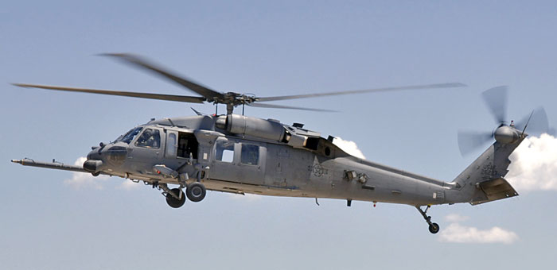
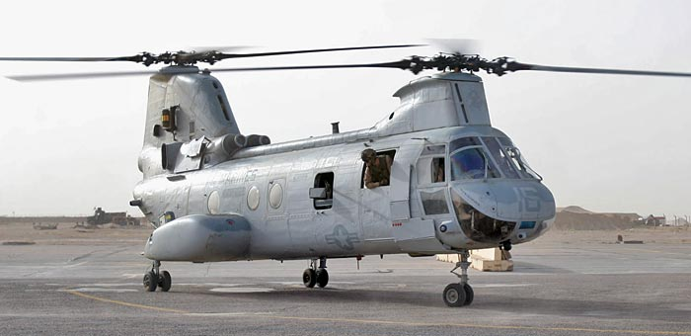
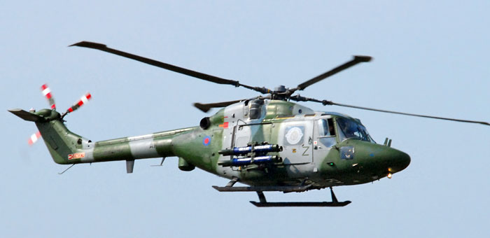
Tail rotors

Slide 30
How does a helicopter achieve horizontal flight?
Notes:
To make the aircraft fly forward, horizontal thrust must be available. In a conventional aircraft this thrust is provided by a jet engine or a propeller. In a helicopter it is done by tilting the lift in the direction of the required movements. This is achieved not by tilting the whole of the rotor head, as one might think. Instead, each blade is hinged, and can be made to rise and fall as it goes round the plane of rotation (or “disc”). To make the helicopter go forward, each blade is made to rise as it reaches the rear of the disc, and descend as it reaches the front.
Thus, the disc is tilted forwards, and there is a horizontal component of thrust to propel the helicopter forwards. Conversely, we could tilt the disc backwards by making each blade rise as it passes over the front and fall as it goes over the rear; the helicopter would move backwards. It could also move sideways by the same principle. The force used to make each blade rise or descend is lift. The pitch angle and hence the angle of attack is increased when the blade is required to rise and decreased for the blade to descend. Obviously, for the rotor disc to stay tilted in the required direction, the pitch of each blade must vary through 360° cycle of travel. Therefore, the pilot’s control used for this is called the cyclic pitch control (or cyclic pitch stick).

Slide 31
Lift
Lift
Thrust
Thrust
The “disc” is tilted, producing a horizontal component of thrust
Notes:
Horizontal movement is achieved by tilting the rotor disc in a chosen direction. In practice this is achieved by allowing each blade to flap up and down independently. A stop is fitted below each rotor blade to prevent it drooping too far when the rotor is stationary. As the main rotor reaches its normal running speed centripetal force pulls the blades up to their normal operating position - rather like spinning a ball around your head on the end of a piece of string. Each blade can now be twisted or feathered by constantly varying amounts as it travels around the disc, producing different amounts of lift at different positions. The next effect of this is that the rotor disc tilts, producing a horizontal component of lift to move the aircraft horizontally.
There is another reason for having the rotor blades free to flap up and down. When the helicopter is moving forwards, those blades that are rotating forward have a combined airspeed of SPEED OF ROTATION + SPEED OF AIRCRAFT (assuming still air). Those blades rotating backwards on the other hand have a combined airspeed of SPEED OF ROTATION - SPEED OF AIRCRAFT.
This difference in speed of airflow over the blades creates different amounts of life on each side of the aircraft and unless corrected would tend to make the aircraft roll. In practice the blades that are moving forward produce more lift, forcing them to rise on their flapping hinge. Since forward moving blades are now flying higher, their effective angle of attack is reduced - decreasing the lift they produce.
In the same way rearward rotating blades tend to produce less lift causing the blades to fall on their flapping hinge - increasing their effective angle of attack and the lift they produce. The resulting tilting of the disc may be seen when a fast moving helicopter approaches an observer.
As well as being free to flap in a vertical plane and to twist on their axes, the blades of most helicopters are free to move in the place of rotation, on drag hinges. This is necessary in order to relieve the bending stresses on the blade roots owing to changes in drag on the blades as they rotate.

Slide 32
Any questions?

Slide 33
Questions for you …..

Slide 34
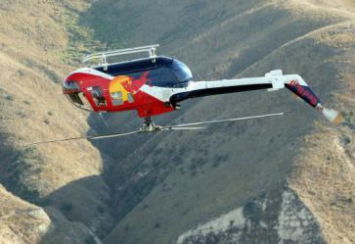
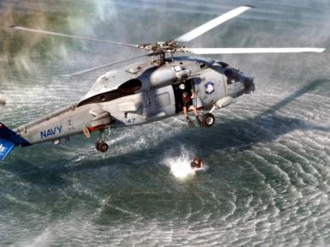
How does a helicopter generate lift?
a. Spinning the main rotor faster
b. Spinning the main rotor slower
c. Increasing the angle of attack of each rotor blade
d. Decreasing the angle of attack of each rotor blade

Slide 35
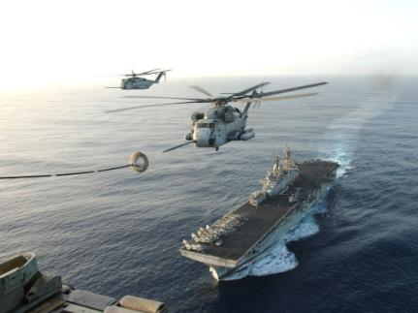
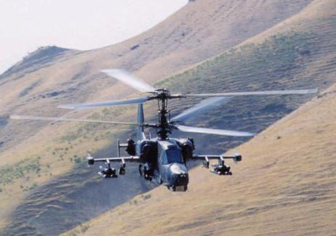
When a helicopter rotor is flown in a circular motion there is an opposing force. What is this force called?
a. Lift
b. Torque reaction
c. Lift reaction
d. Drag

Slide 36
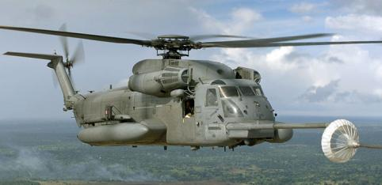
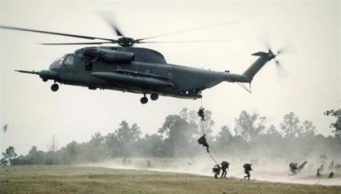
What is the purpose of a tail rotor?
a. Counter torque reaction
b. Reduce drag
c. Provide thrust
d. Control the helicopter in the rolling plane

Slide 37
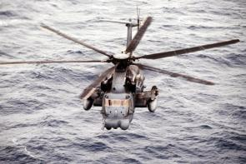
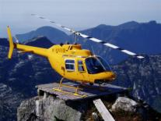
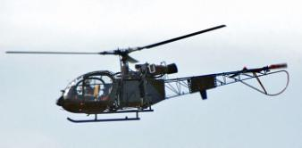

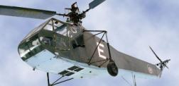
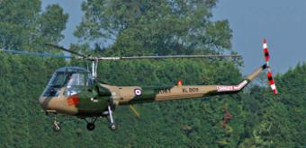
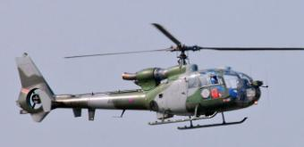
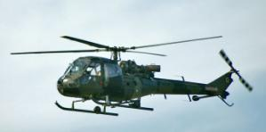
What are the three controls a helicopter uses to control the aircraft’s attitude?
a. Collective, cyclic, yaw pedals
b. Ailerons, rudders
c. Cyclic, elevators, throttle
d. Yaw pedals, fin, rotor

